Slide 1
Cities of the Future:
Planning for an Inclusive Sri Lanka
Sumila Gulyani
Urban Analytics and Strategy Global Lead
World Bank

Slide 2
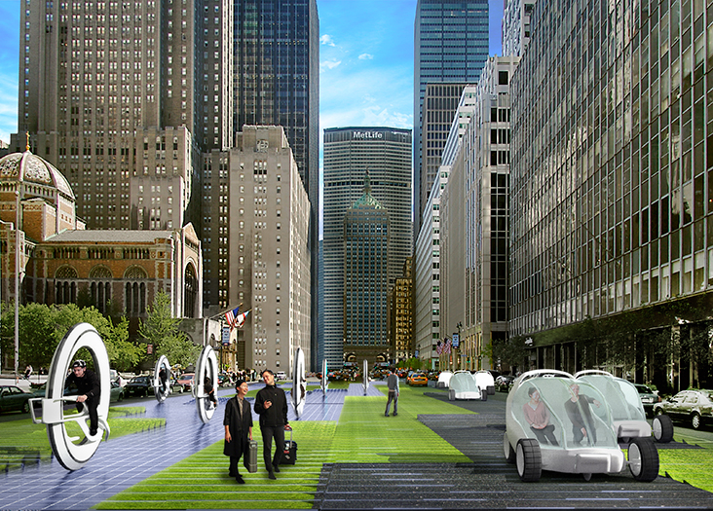
What is the reality of future utopian visions?
Notes:
Future city visions are utopian and motivating
But they also need to make sure the point of departure is based on reality of current development
That particularly includes all urban residents

Slide 3
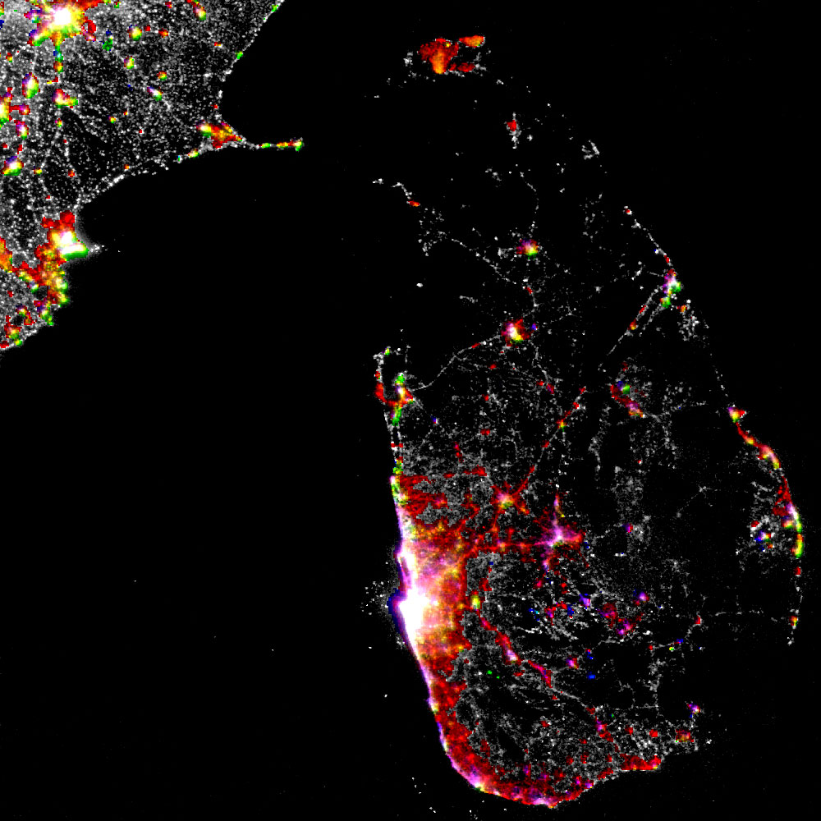
Existing Conditions in Sri Lanka
Multicity agglomerations along West Coast
Development along transport corridors
Need to coordinate regional governance
Notes:
What is the current situation in Sri Lanka?
Night-time lights image
Red shows where growth has occurred 2002-2012
Growth along transport arteries (e.g. Colombo – Kandy corridor) reflects ribbon development
Two types of agglomerations: (a) multi-city agglomerations covering multiple municipal/urban councils in West and South of country; (b) “single city” agglomerations in East (e.g. Batticaloa and Trincomalee) and North (Jaffna)
Note very rapid growth around Jaffna

Slide 4
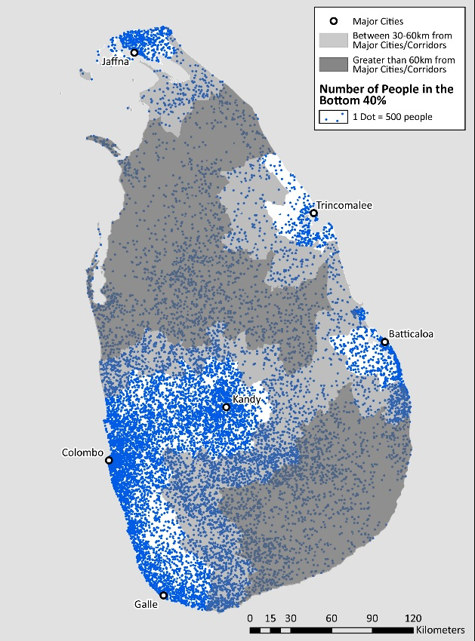
Agglomerations are defined by:
Concentrated poverty
Highest potential for future economic growth
Notes:
Poverty rates are (more or less) spatially uniform across the country
=> spatial distribution of absolute number of poor and vulnerable follows spatial distribution of population
=> majority of poor and vulnerable located in close proximity to major urban centers – large share in close proximity to Colombo metro region, Kandy, and Galle-Matara
Good news: these are also the areas with the highest levels of economic potential
=> policies to improve working of agglomerations can have major poverty reduction impacts

Slide 5
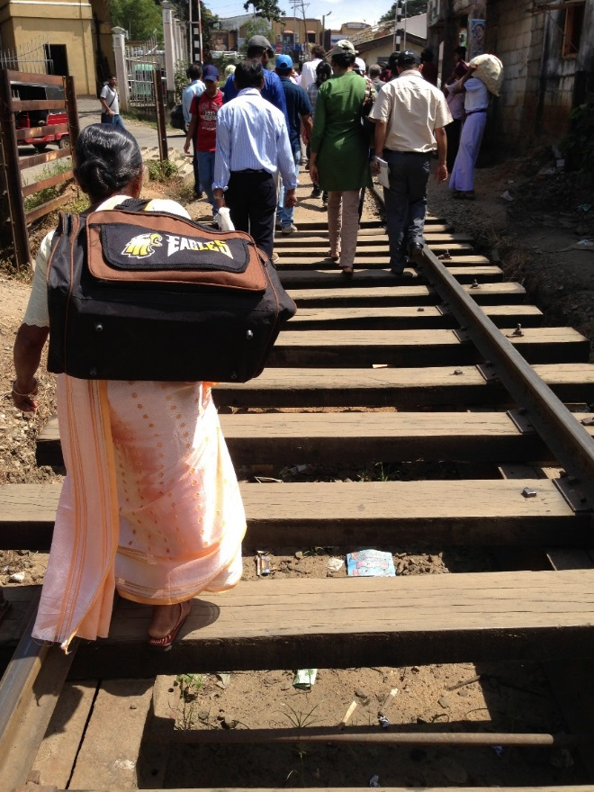
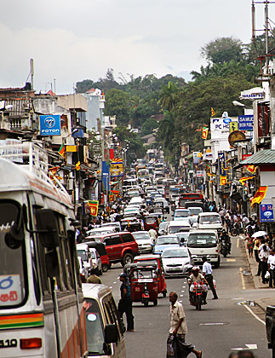
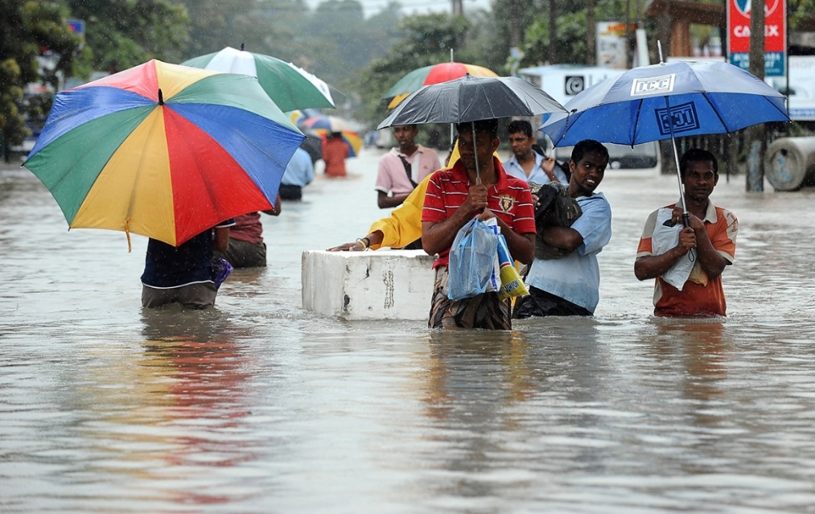
Infrastructure deficits limit livability
Poor pedestrian walkability
Congested roads
Inadequate Drainage
Notes:
Kandy = Sri Lanka’s second most populous city
Pedestrians forced off sidewalks and people using (active) train tracks to make their way from bus station to city center
In some areas, most vibrant areas not along streets but in-between buildings
And these zones offer a lot of potential in terms of offering dedicated spaces, away from roads for pedestrian walkability
Pp 137-138 of report
80 % of major SAR cities exposed to floods & 45 % of urbanized areas in flood-prone areas
Colombo - major flooding in 2010

Slide 6
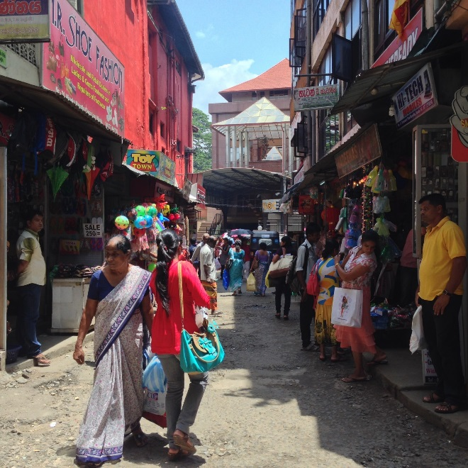
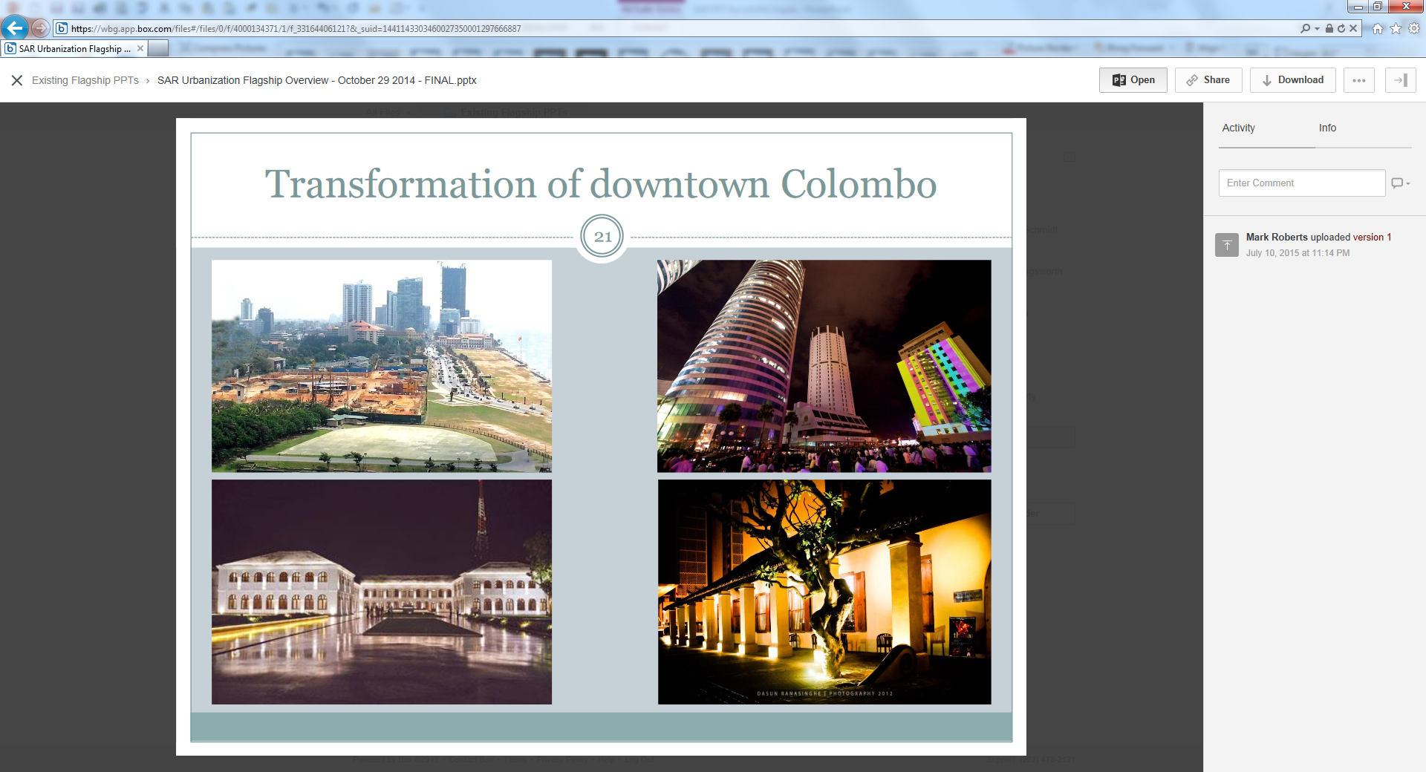
But also offers opportunities…
Vibrant in-between spaces
Urban rejuvenation

Slide 7
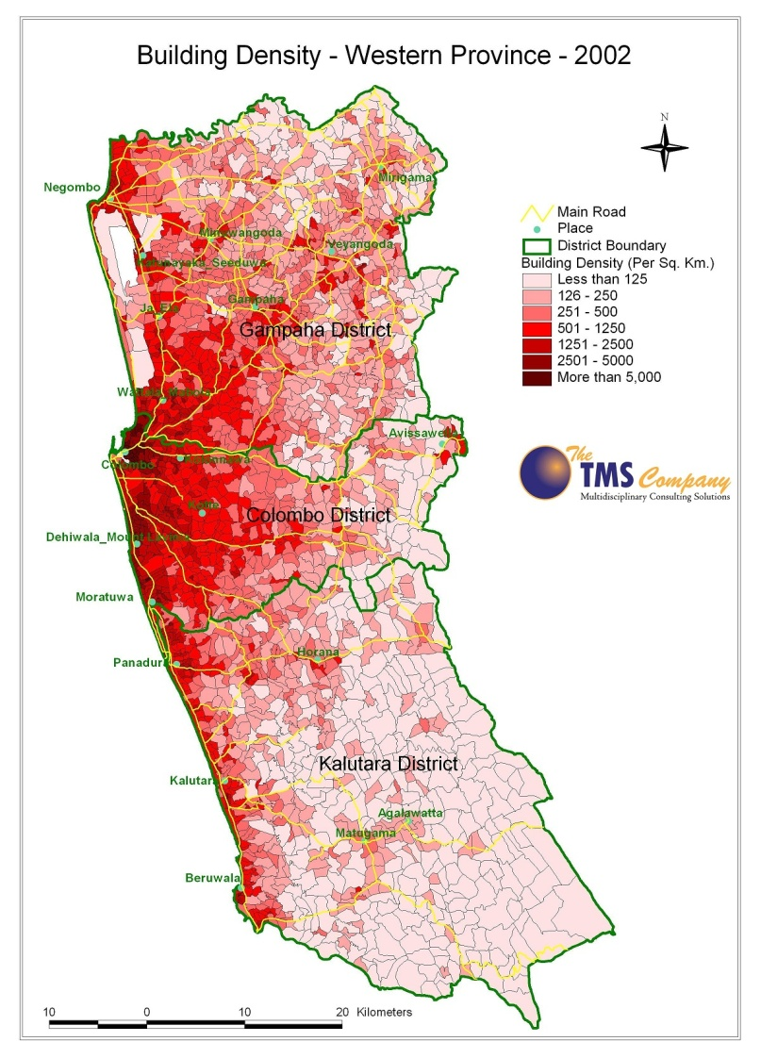
Moving forward: Space & Citizens
Managing Sprawl & Ribbon Development
Current pattern leading to congestion
Need to coordinate development
Notes:
Spatial structure of the city
Citizen well-being
Multi-city agglomerations – improved planning & coordination to bring patterns of sprawl & ribbon development under control
Patterns are contributing to severe traffic congestion => undermining agglomeration benefits

Slide 8
A citizen centric planning framework
Notes:
Note: Data are for another country: a sample of about 15,000 households from 15 cities.

Slide 9
Planning for Inclusion
Development decisions of today have long term lock in effect
Sri Lanka’s policymakers must focus on alleviating both current and future congestion pressures and facilitate agglomeration economies
Improvements in urban governance and finance are key
This offers the chance to make the region’s and Sri Lanka’s cities prosperous and livable

